Slide 1
G9 BIOLOGY GROUP PROJECT
Logistic Growth
Interactive Web Simulation of Population Models
How do growth rate and limited resources shape a population?
Biology Lead: Eason
Web Development Lead: Ray
Data Analyst: Patrick
Demo Coordinator: Yoyo
1 / 7

Slide 2
What is logistic growth?
A population grows quickly when resources are plentiful.
Competition increases as population size rises.
Net growth slows near carrying capacity, K.
A small starting population can produce an S-curve.
Net growth is fastest at N = K/2.
2 / 7

Slide 3
Formula and variables
dN/dt = rN(1 − N/K)
N: population now N₀: starting population
r: intrinsic growth rate per day
K: carrying capacity in individuals
1 − N/K: density limits potential growth
Example: 0.2 × 500 × (1 − 500/1000) = 50 individuals/day
3 / 7

Slide 4
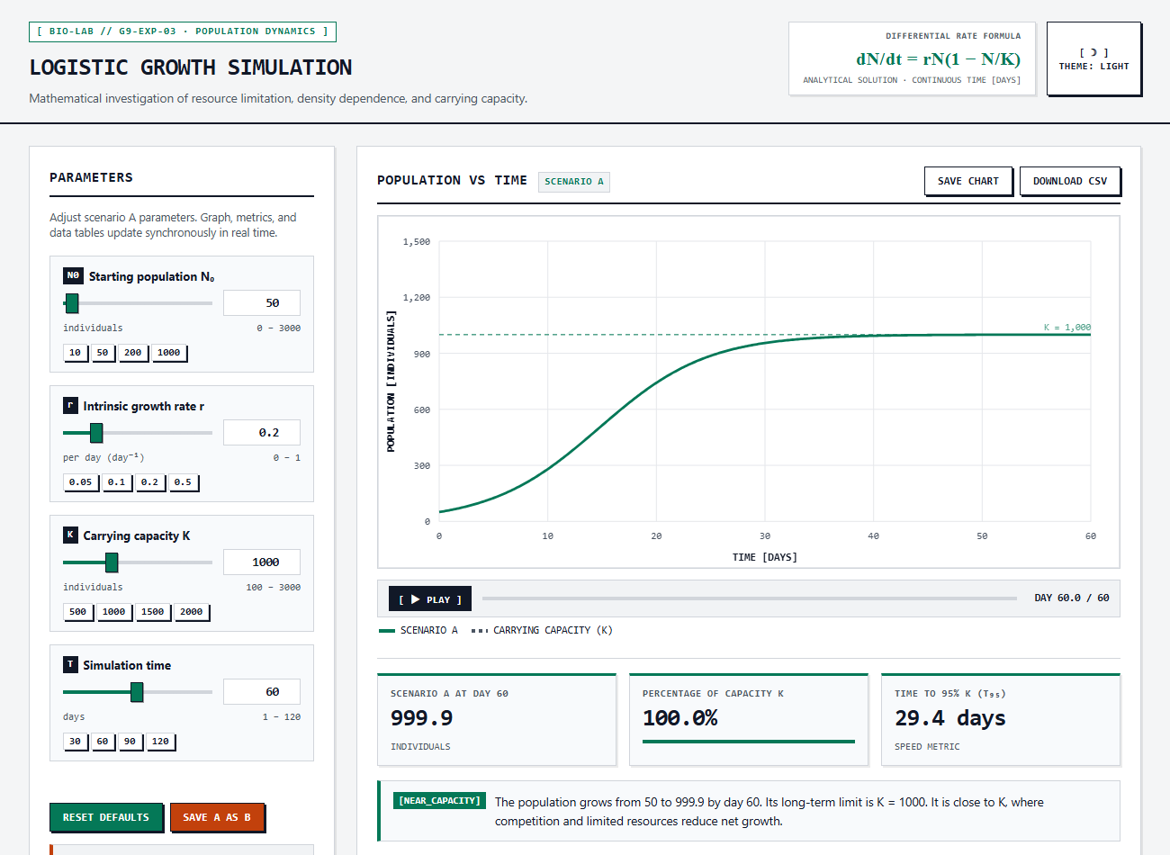
Our interactive simulation
Adjust N₀, r, K and simulation time
Save A as B for a fair comparison
One-click experiments, CSV and chart export
Play displays the calculated curve over time
Exact solution checked against independent numerical integration.
Boundary checks: N₀ = 0, r = 0, N₀ = K and N₀ > K.
4 / 7

Slide 5
Experiment 1: growth rate
Fixed N₀ = 50 and K = 1000
r = 0.1, 0.3 and 0.5 per day
Time to 95% K: 58.9, 19.6 and 11.8 days
Higher r speeds up growth; the long-term K is unchanged
Model predictions for 60 days. Displayed values are rounded.
5 / 7

Slide 6
Experiment 2: carrying capacity
Fixed N₀ = 50 and r = 0.2 per day
K = 500, 1000 and 1500 individuals
Day 60 populations: 500.0, 999.9 and 1499.7
Higher K raises the long-term population limit
Model predictions for 60 days. Displayed values are rounded.
6 / 7

Slide 7
Assumptions, limitations and conclusion
MODEL ASSUMPTIONS
REAL-WORLD LIMITATIONS
Closed population: no immigration or emigration
Real environments and individuals vary
Constant r and K, with immediate density effects
Migration, chance events and delays can cause fluctuations
r controls growth speed. K sets the long-term limit.
For positive r and N₀, under the stated assumptions.
7 / 7

